Slide 1
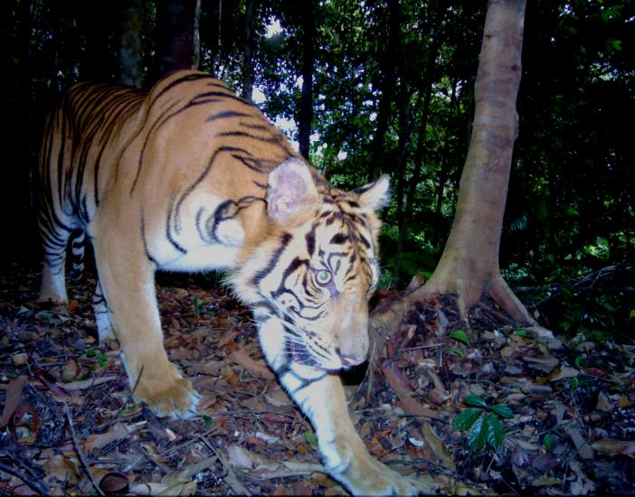
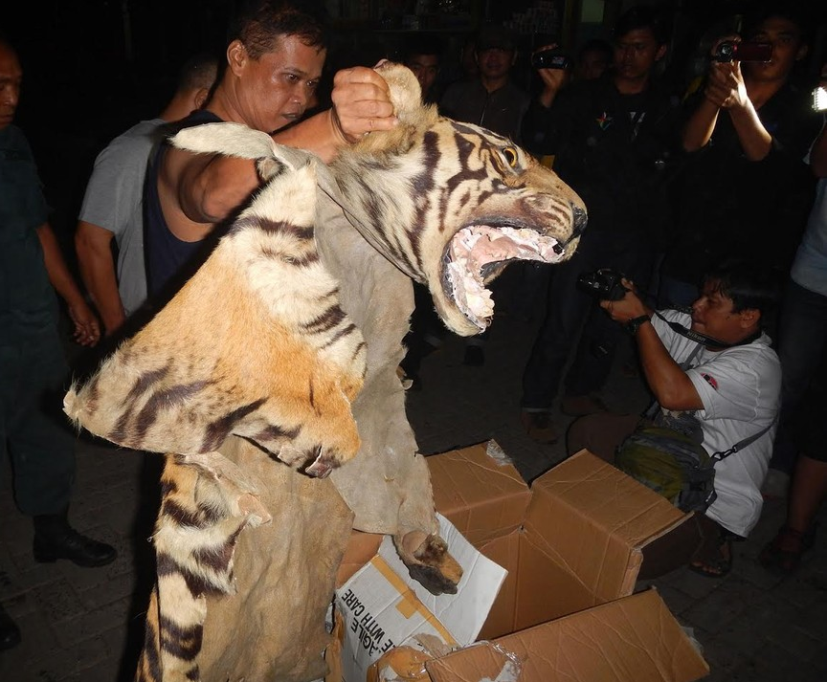
WILDLIFE CRIME IN INDONESIA
LEGAL FRAMEWORKS, CURRENT KNOWLEDGE AND PRIORITY ACTIONS

Slide 2
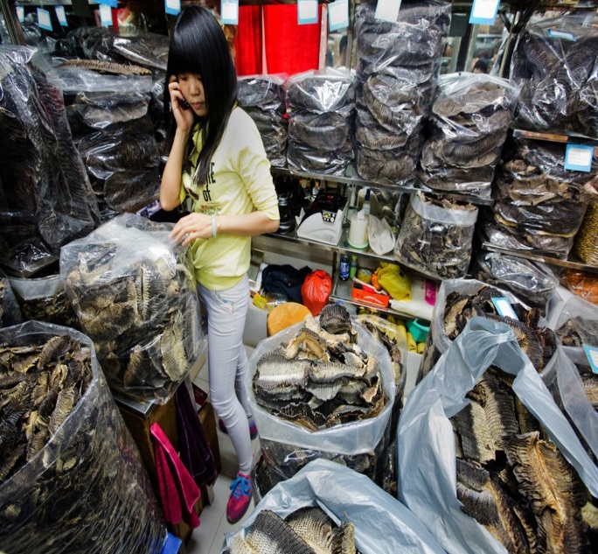
INDONESIA’S WILDLIFE CRIME: A ‘SUPER WICKED’ PROBLEM?
No right or wrong solutions
Novel and unique
Not managed by a central authority
No stopping rule - will continue indefinitely
Requires widespread behavioural change
Policies to solve the problem discount the future irrationally

Slide 3
What are the next
steps?
What is the scale of the problem ?
What does the legislative framework look like?
Strategic recommendations from both reports
‘Wildlife Crime in Indonesia: A rapid assessment of the current knowledge, trends and priority actions’
‘Wildlife Trade, Wildlife Crimes and Species Protection in Indonesia: Policy and Legal Context’

Slide 4
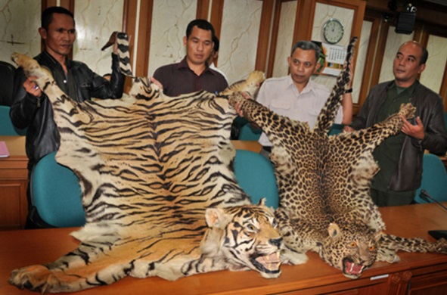
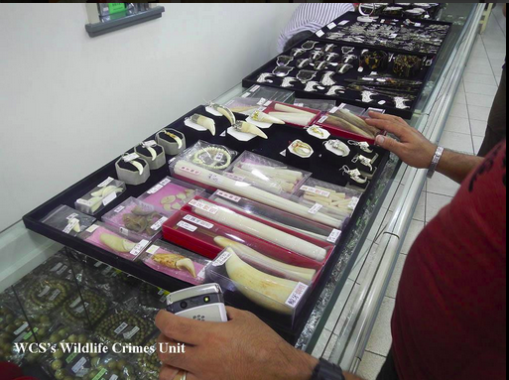
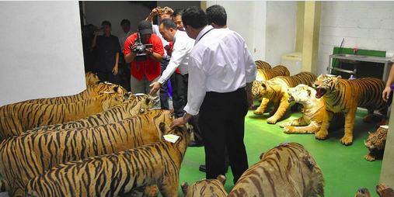
Wildlife Crime In Indonesia: Policy And Legal Context
Legal Scope
Implementation and enforcement
5 challenge clusters identified
Detection and Reporting
Registration and prosecution
Arrest and Detention

Slide 5
EXAMPLE: Legal Scope - Identified Challenges
Legal Scope
Revision of GR No.7/1999
GR No. 7/1999 fails to protect CITES listed species, and other species that are of critical conservation concern in Indonesia.
Reform of Act No.5/1990
No provisions for non-native species protected under CITES (e.g. African ivory).
No legal conservation of species outside protected areas – no connection of species protection to critical habitats.
Enforcement powers of forestry investigators are limited
The CITES management authority for marine species is currently MoEF – and marine species have insufficient focus. This could be revised

Slide 6
EXAMPLE: Legal Scope - Possible actions
Legal Scope
Revision on species protection – GR. No.7/1999, to align with CITES as a minimum.
Revision of penalties: higher fines – max./min. sentences
Removal of various exclusion clauses (wildlife as gifts)
Increase authority of forestry and civil investigators and increase their powers of arrest and investigation
Allow prosecution of civil suits – e.g. enable legal action to be taken against government officers for failure to enforce existing legislation.
Online trading of wildlife trade – e.g. allowing photos, videos and online as admissible evidence in wildlife crime cases.
Link protected species with their habitats on GR No.7/1999.

Slide 7
OTHER IDENTIFIED CHALLENGES
Minimal crime detection – few staff, limited ground based actions.
Insufficient knowledge/training for enforcement officers
Detection and Reporting
Forestry PPNS cannot arrest suspects of ‘wildlife crime’.
Improper legal process often leads to early case dismissal.
Lack of technical knowledge within police investigators and prosecutors.
Investigation of online wildlife trading is limited and is restricted to investigators without expertise in wildlife trade.
Arrest and Detention
Registration and prosecution
Sentencing is often based on ‘state losses’- these are difficult to determine for wildlife crime.
Limited collaboration – police/military, forestry rangers, civil investigators, and the public.
Implementation and Enforcement
Legally permitted quotas on harvesting of CITES-listed species are poorly established and poorly monitored.

Slide 8
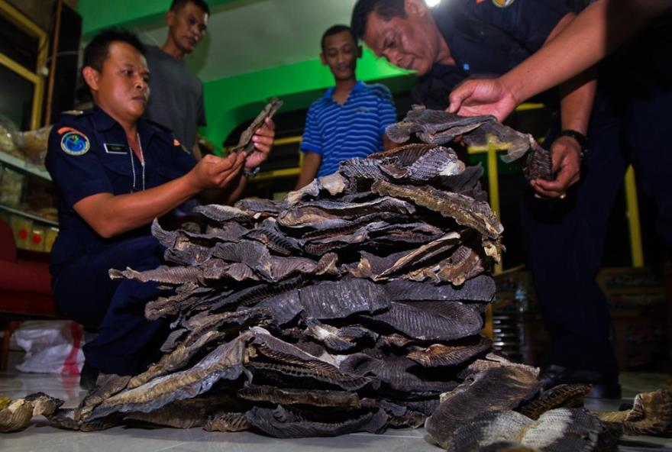
SUMMARY: POLICY AND LEGAL CONTEXT
On paper, Indonesia’s legal framework for combatting wildlife crime appears comprehensive and sufficient.
In reality, significant legal loopholes exist which facilitate and perpetuate wildlife crime at industrial volumes.
Act No. 5/1990 and GR.No.7/1999 are key targets for reform.
Many options exist for immediate improvements in enforcement, and to increase the rate of successful prosecutions.

Slide 9
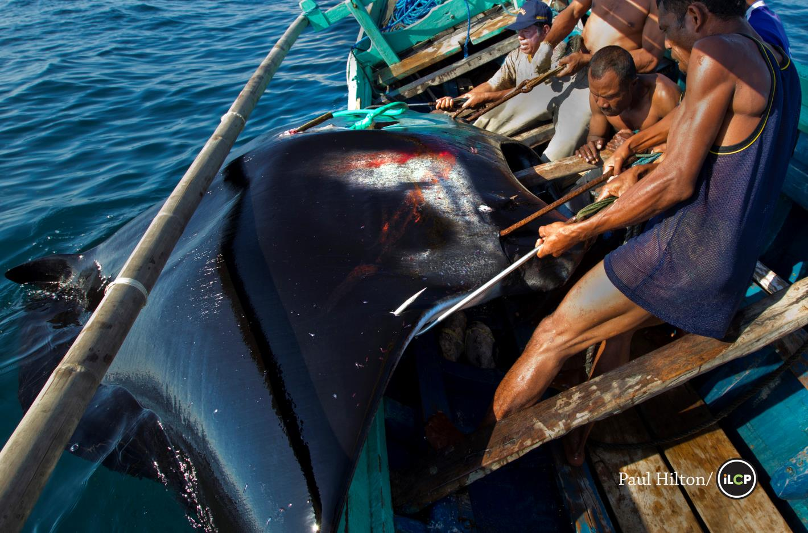
current knowledge, trends and priority actions

Slide 10
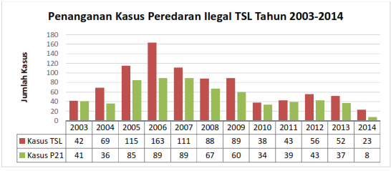
WILDLIFE TRADE: KEY TRENDS
Government statistics show a downward trend in cases.

Slide 11
TRADE VOLUMES + DEMAND: KEY TRENDS
Data is very species specific and/or site specific, so accurate national or provincial scale assessments are currently impossible.
All signs (expert respondents, seizures, observations) indicate illegal wildlife trade in Indonesia is rapidly increasing, in line with increasing domestic/regional/global demand.
Domestic demand is key for some species – particularly birds. In 2008, poaching rates for parrots from North Halmahera, Maluku were an estimated at just under 1000 birds annually , 41% for export (Philippines), and 59 % for domestic trade.
When trade in one species appears to fall, it usually reflects a switch to a different species. The trade in Indonesia is very dynamic..
Trade in tigers, hornbills, elephant ivory, pangolins and other species is estimated to have increased four fold since 2010 according to respondents.
4

Slide 12
Indicators of VOLUME
81,689
Number of pig nosed turtles seized in Indonesia between 2003-2012 destined for export (2012)
1,320
Number of manta rays in Indonesia killed annually for their gill rakers before the ban (2012).
3-5
Number of live Sun-bears exported per day from Indonesia (2008)
1260kg
The ivory sales from a single trader in Lampung since 2003 – equivalent to 47 elephants (2014)
55
Number of tiger related cases investigated by WCS Wildlife Crime Unit since 2003 (2015)

Slide 13
Indicators of volume
5,000
Number of helmeted hornbills poached between 2012-2013 across Indonesia (2014)
714
Number of slow loris (Nycticebus coucang) observed for sale in 2 markets in Medan between 1997-2008 (2008)
25t
A single shipment of pangolin scales observed in Sumatra in 2008. Equivalent shipments are thought to be leaving Sumatra each month. One kilo of pangolin scales is equivalent to 4 animals (2008)

Slide 14
MARKET CHARACTERISTICS: KEY TRENDS
Wildlife trade is increasingly well organised – visibility is declining though still relatively open compared to many countries.
There are reports of hunters being equipped and funded by buyers/traders to collect specific species – ‘poaching to order’
Online trade is growing rapidly in response to limited enforcement capacity.
Wildlife traders are increasingly using disconnected network systems, like drug traffickers, as well as unidentified methods to get through custom exit points.
ü
@@@
A
B

Slide 15
MARKET values
$194 - $6,400
Per bill cost of ‘red’ hornbill ivory in Indonesia, and the per kilo cost of hornbill ivory in Chinese markets – 5x higher than elephant ivory
$16,000
Value of an Indonesian Palm cockatoo
(Probosciger aterrimus) on the international market.
$6,000,000
Value of shark fins extracted from West Nusa Tenggara in 2012 on the international market (434t).
$50 – $45,000
Value of an orangutan in Indonesia, and its international market price. WCS WCU has investigated 85 cases involving 545 live primates since 2003..

Slide 16
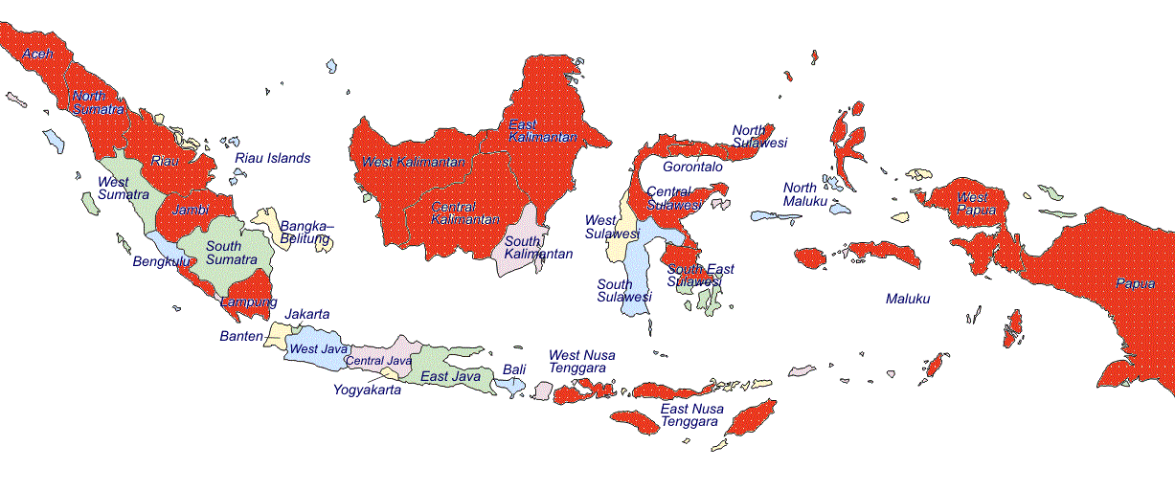
Extraction areas
Extremely high extraction rates indicated from almost all areas in Indonesia: (see red provinces below:
But, data is deficient on specific volumes and scale of the trade in all areas.

Slide 17
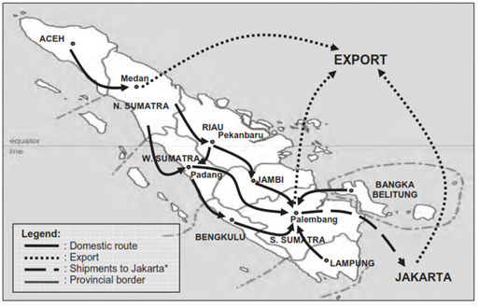
Trade routes
Trade routes within Indonesia are complex, involve multiple steps, and are very species specific.
Pangolin trade routes in Sumatra are shown below.

Slide 18
PRIORITY ACTIONS
Some top priority actions to reduce the volume of Indonesia’s illegal trade in wildlife:
Legal reform
Legal reform
Regulate legal trade – quota monitoring
Int’l engagement on wildlife crime
Accountability, efficiency and morale of enforcement agencies
Accountability, efficiency and morale of enforcement agencies
Reducing hunting and poaching – increase ground patrols
Focus on criminal kingpins and elite buyers – PPATK/KPK
Inter/intra agency coordination and data coordination/ sharing
REDUCESUPPLY
REDUCE DEMAND

Slide 19
CRITICAL GAP: Data availability
Many organisations and agencies hold data which is critical to assess the scale of wildlife trade, and to target interventions.
BUT
Data is collected in different formats, for different purposes (e.g. prosecution vs. monitoring)
There are numerous databases – which cannot talk to each other, and are not well utilised.
Data sharing agreements exist, but they are not well implemented or enforced.
Data is not shared between departments in the same ministry, or between field offices and Jakarta.
NGOS
MMAF
CIVIL SOCIETY
BKSDA
QUARANTINE
MoEF
CUSTOMS
OTHER MINISTRIES

Slide 20
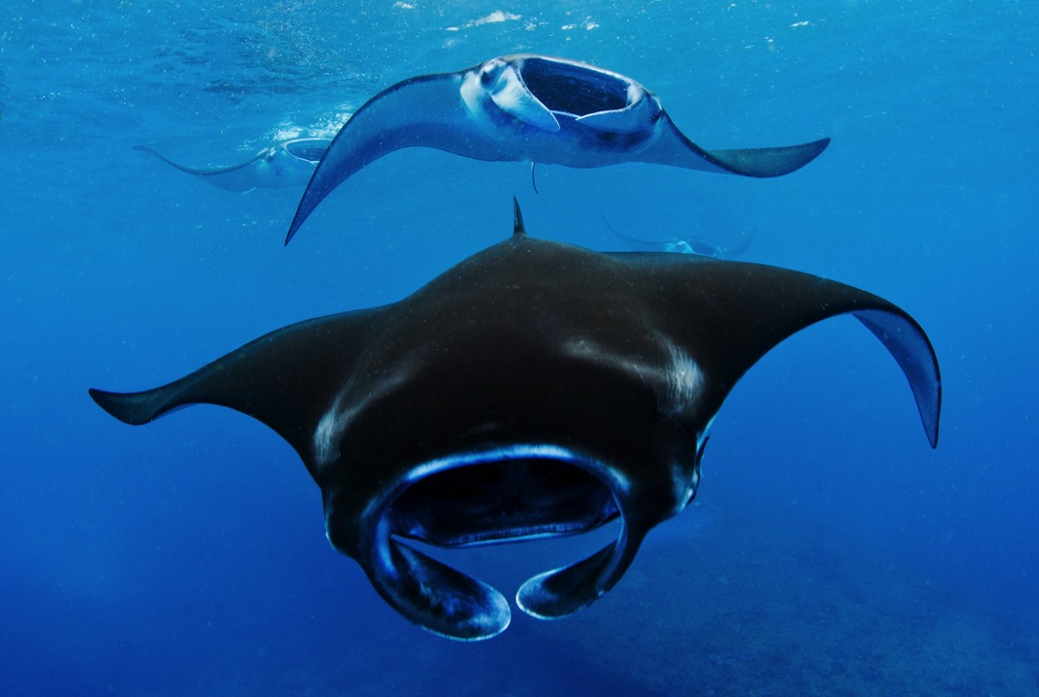
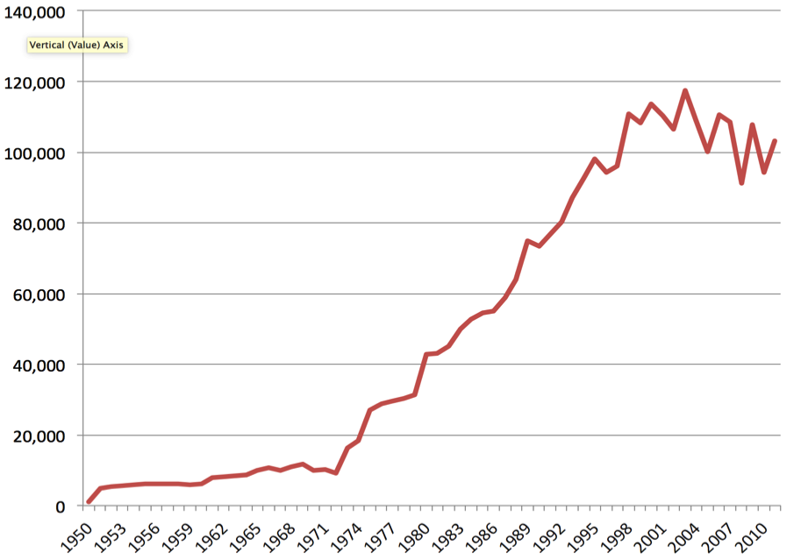
Solutions are possible: manta rays
Indonesia is the world’s largest shark fishery (>120,000 tons/year)
January 2014:
Indonesia declares mantas a protected species
April 2015:
8 arrests; 6 prosecutions finished; sentences up to 1.5 years; major traders no longer selling manta products
before 2012 2013 2014 2015
March 2013:
CITES lists Mantas and 5 shark species on Appendix II for the first time
22 August 2014:
First ever arrest of a manta ray trader, by MMAF, facilitated by WCS-WCU.

Slide 21
WCS response
Expanding the WCU – scaling up to new areas (Eastern Indonesia), new species groups (mantas, hornbills, etc.), and new approaches such as using anti-money-laundering legislation (MoUs with PPATK) and
Supporting Indonesian government law enforcement agencies (Police, AGO, Customs, MoEF) to undertake transboundary enforcement cases (with Malaysia, Thailand, Vietnam)
MoEF (PHKA) has invited WCS to advise on the revision of Act No.5/1990 with the DPR, and the revision of PP.7/1999 (the protected species list)
The revision of PP.7/1999 is particularly urgent, so workshops are planned this year
MoEF (PHKA) has invited WCS to help with revision of a case tracking database for forestry/wildlife crimes (SIMPAK)
Capacity-building support to Eijkman Institute (wildlife forensics, with the TRACE Wildlife Forensics Network), INP-CID, MoEF and the AGO
Development of a wildlife trade analytics networks

Slide 22
Thank you

